Slide 1

MULTI RESTAURANT
Submitted By:
Bhanu Sriteja - 211801340002 Sri Priya - 211801340013
Indu - 211801340005
Aryaman - 211801340020
Mahesh - 211801340019
Suresh - 211801340016
Under the esteemed guidance of:
Aswini Kumar (M . Tech)
Assistant Professor
Department of Computer Science and Technology,
School of Engineering and Technology,
Centurion University of Technology and Management, Vizianagaram

Slide 2
ABSTRACT
The Multi-Restaurant Management System, developed with Spring Boot and ReactJS, is a comprehensive web application designed to streamline the operations of multiple restaurants within a unified platform. Leveraging the robust backend capabilities of Spring Boot and the dynamic frontend interface provided by ReactJS, the system encompasses key features such as secure user authentication, centralized multi-restaurant dashboards, intuitive menu management, efficient order processing, inventory tracking, customer interaction, and payment integration. The integration of responsive design principles ensures a consistent and user-friendly experience across various devices. The system also incorporates reporting and analytics tools to empower restaurant owners with valuable insights. With a modular and scalable architecture, this project aims to enhance operational efficiency, improve customer experience, and provide actionable data for informed decision-making within the complex landscape of multi-restaurant management.

Slide 3
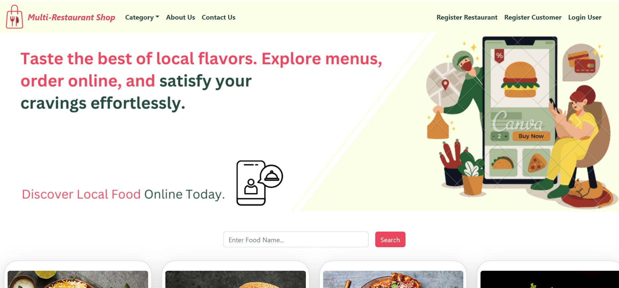
INTRODUCTION
ReactJS facilitates the creation of dynamic and responsive user interfaces, ensuring an engaging experience for customers navigating menus, placing orders, and tracking deliveries.
Meanwhile, Spring Boot empowers the backend with scalable and high-performance services, allowing for the efficient management of multiple restaurant operations.
With features such as multi-restaurant support, order management, and real-time updates, this system not only enhances the operational efficiency of each establishment but also promises a secure and scalable platform for the evolving landscape of the food service industry.

Slide 4
EXISTING SYSTEM
Square for Restaurants provides a range of tools for managing orders, payments, and menus. It integrates with various Square hardware and software solutions.
OpenTable is primarily known for its reservation system, allowing restaurants to manage bookings efficiently. It also offers guest management and analytics tools.
Order and Delivery Management:
Placing and tracking orders.
Assigning and managing delivery personnel.
Real-time order tracking for customers.
Restaurant Management:
Menu management: Adding, updating, and removing items
Order management: Receiving and processing orders

Slide 5
PROPOSED SYSTEM
Develop an intuitive order management interface that allows staff to view and process incoming orders efficiently. Implement features for order tracking, status updates, and order history.
Utilize React.js to create a flexible and dynamic menu management system. Allow restaurant owners to easily customize menus, add new items, update prices, and manage categories.
Implement a secure user authentication system to ensure that only authorized personnel have access to the system. This may include roles for administrators, managers, and staff.
Integrate a relational database (e.g., MySQL) to store data such as user information, orders, menus, and customer feedback. Utilize Spring Data JPA for seamless database interactions
Implement security measures using Spring Security to protect sensitive data and ensure secure user authentication and authorization. Use encryption for data transmission and storage.
Implement logging and monitoring features to track system activities, detect potential issues, and facilitate troubleshooting

Slide 6
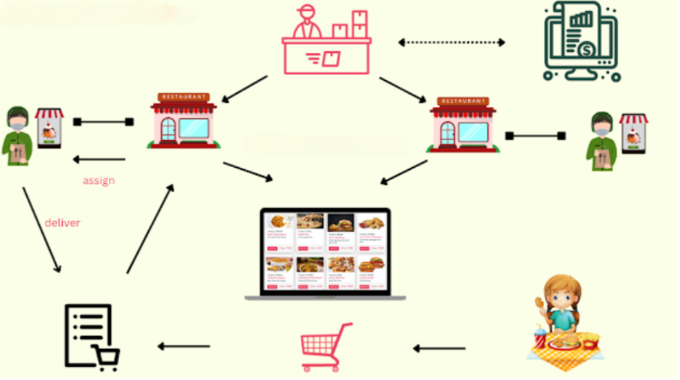
PROJECT OVERVIEW

Slide 7
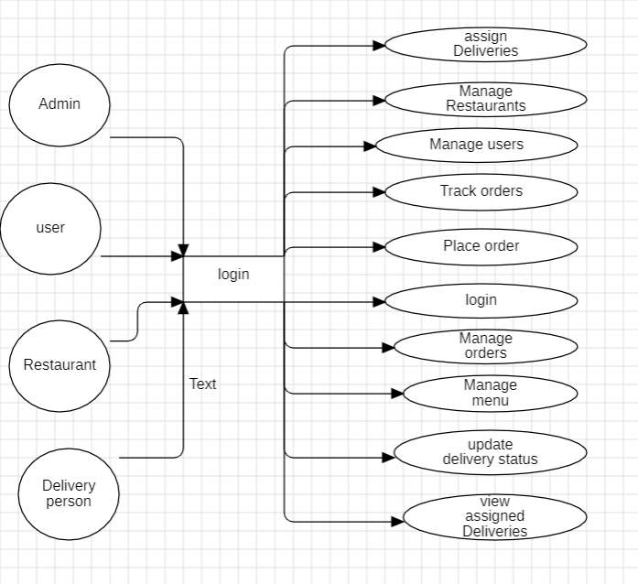
USER DIAGRAM

Slide 8
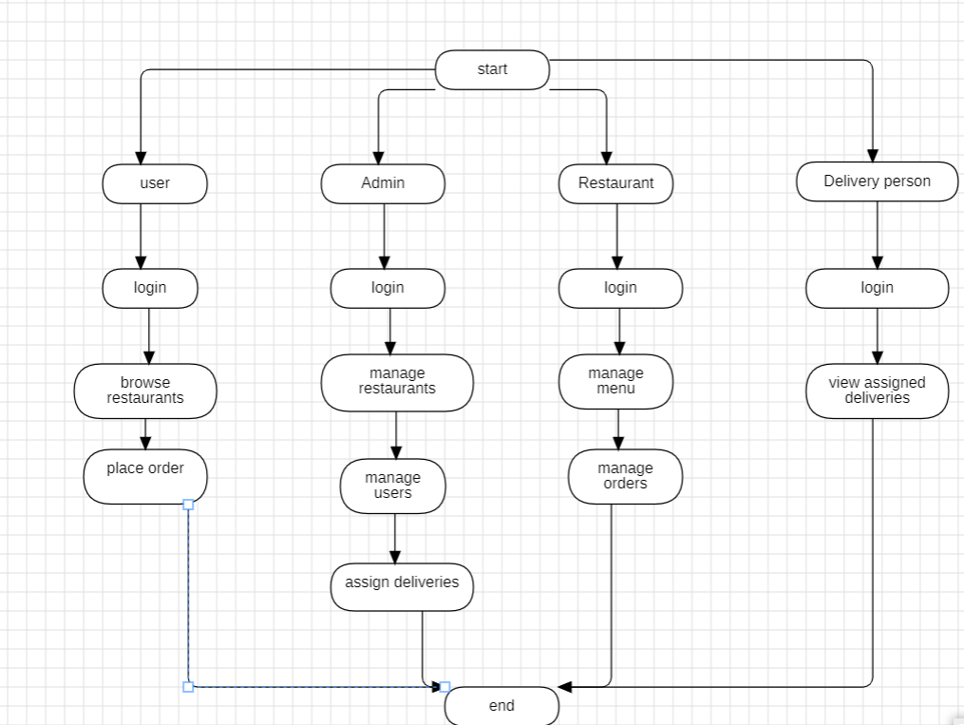
FLOW CHART

Slide 9
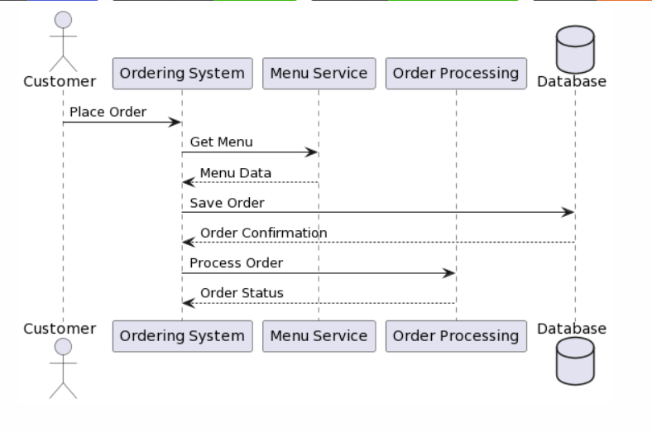
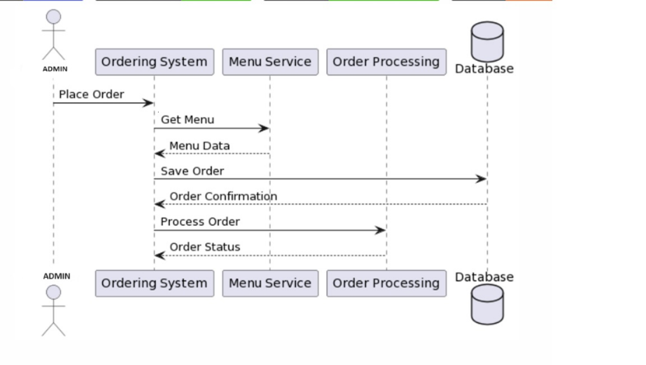
SEQUENCE DIAGRAM
CUSTOMER
ADMIN

Slide 10
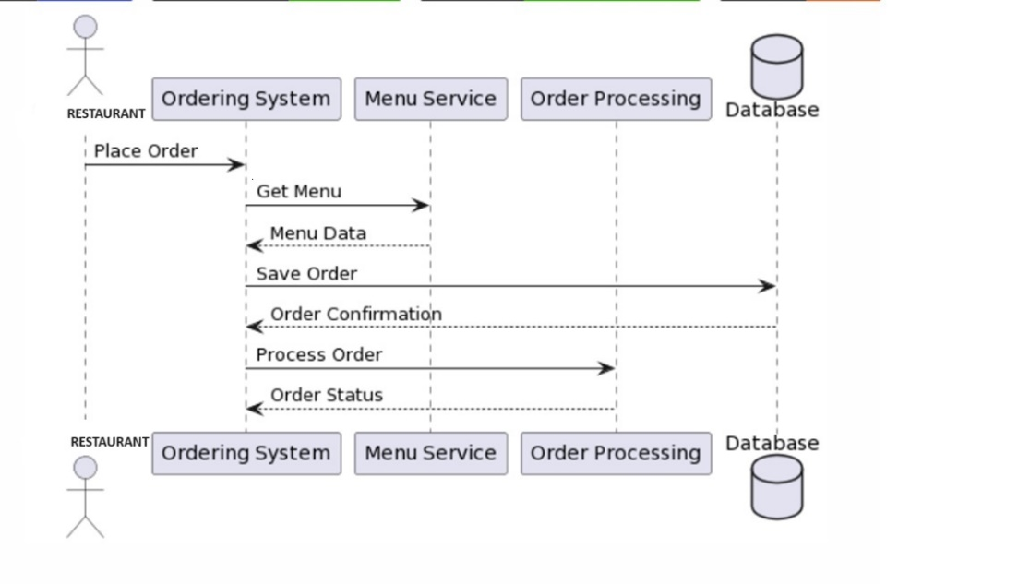
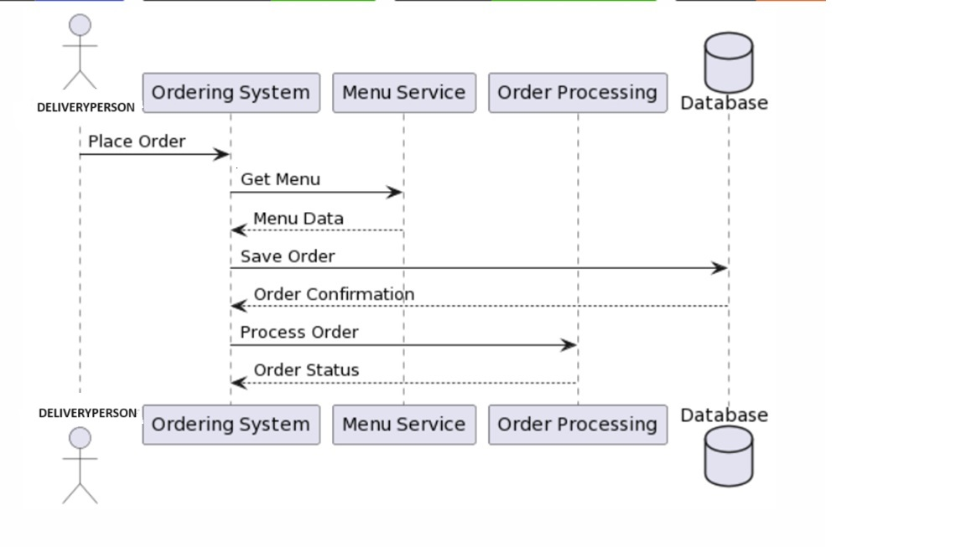
SEQUENCE DIAGRAM
RESTAURANT DELIVERY PERSON

Slide 11
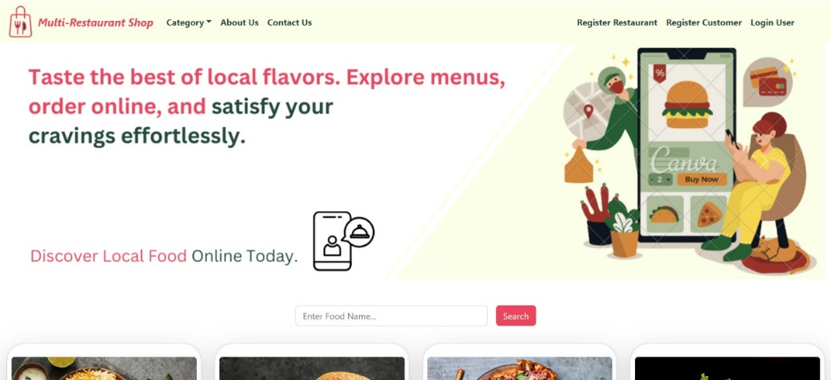
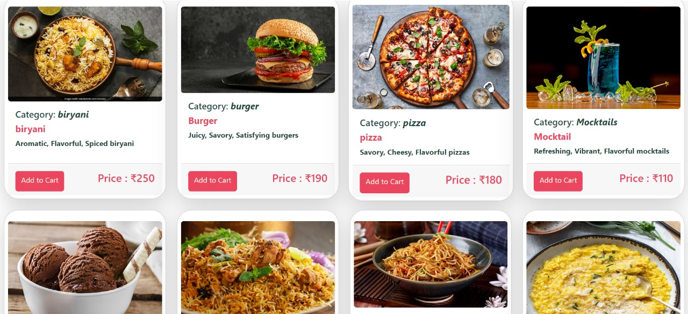
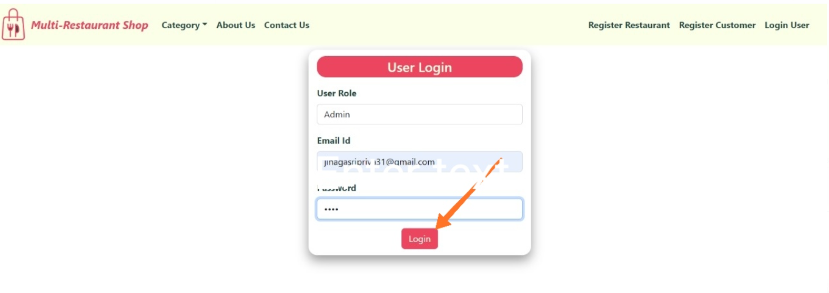
CUSTOMER OUTPUTS
Guest User Home page Guest User Menu Items
Customer Login page

Slide 12
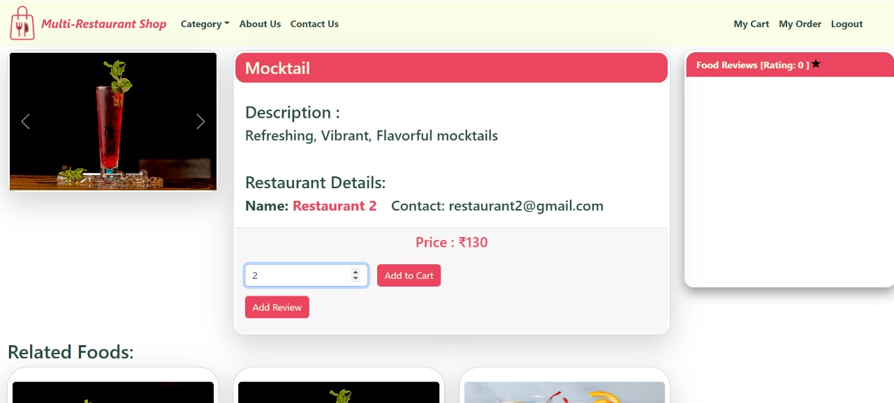
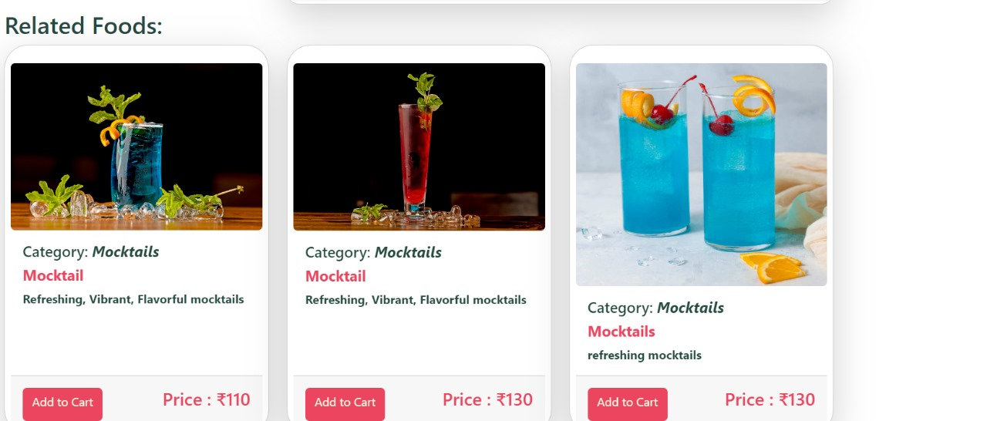
CUSTOMER OUTPUTS
ADD TO CART
SUGGESTIONS

Slide 13
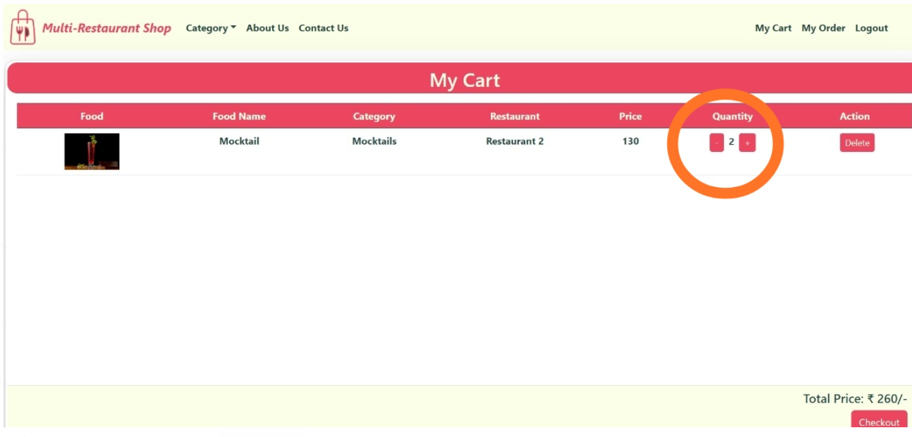
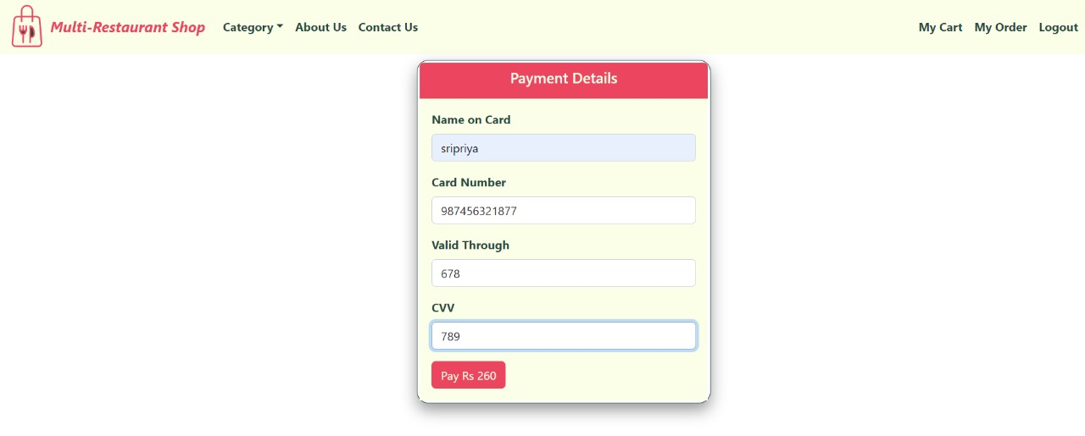
CUSTOMER OUTPUTS
MY CART
PAYMENT DETAILS

Slide 14
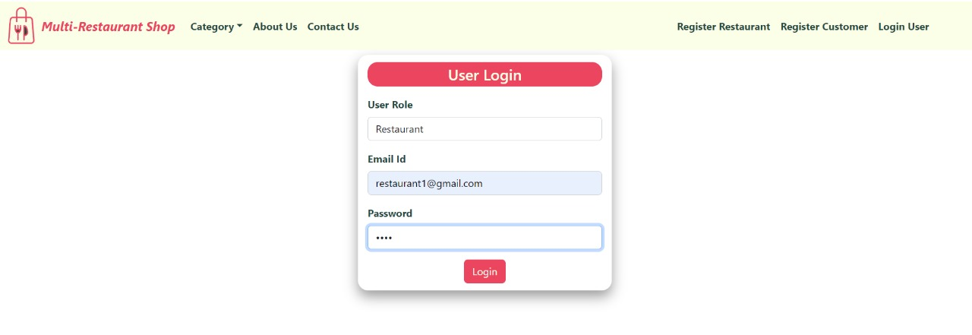
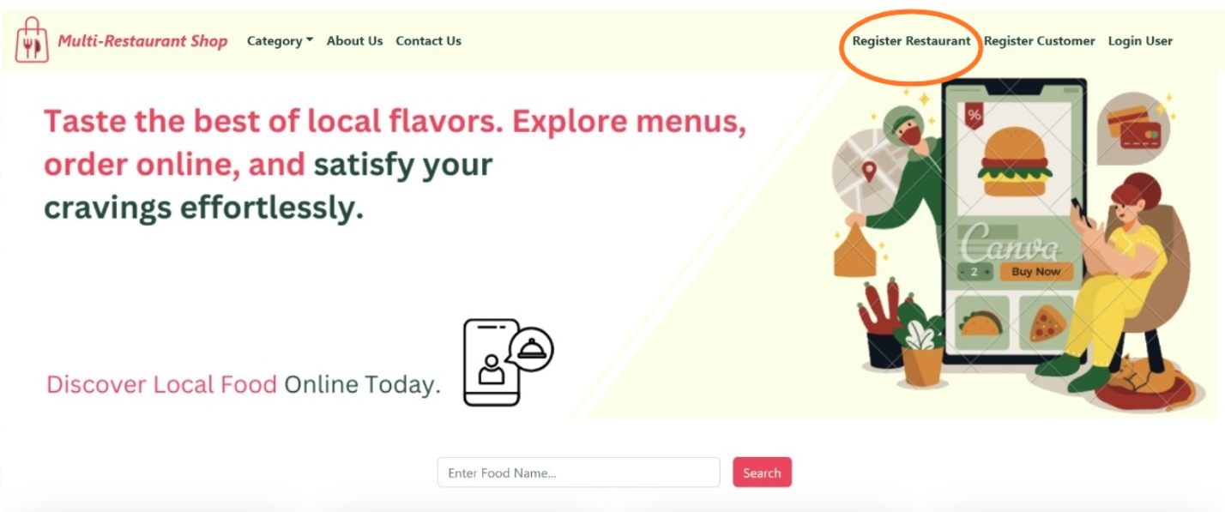
RESTAURANT OUTPUTS
Restaurant Login Page
Restaurant Home page

Slide 15
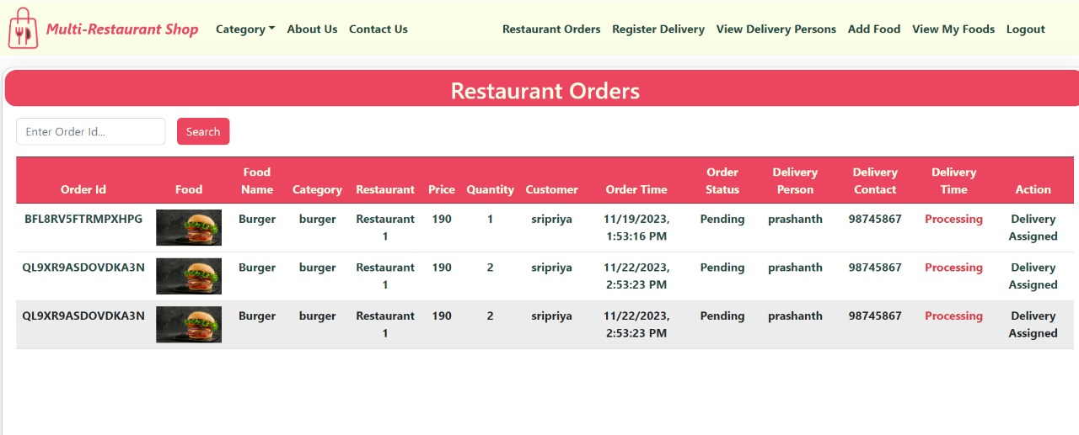
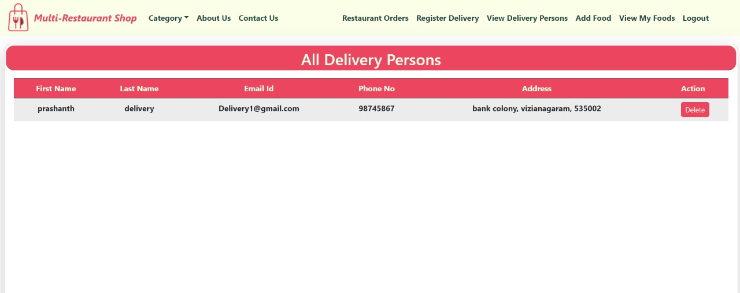
RESTAURANT OUTPUTS
Restaurant Orders
All Delivery Persons

Slide 16
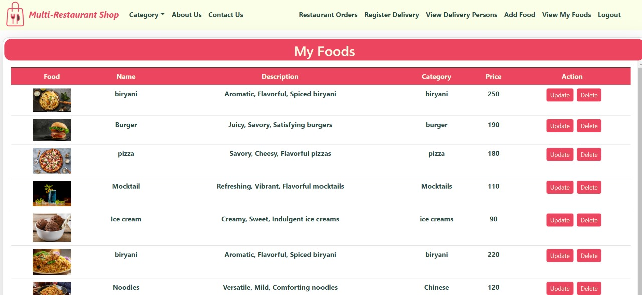
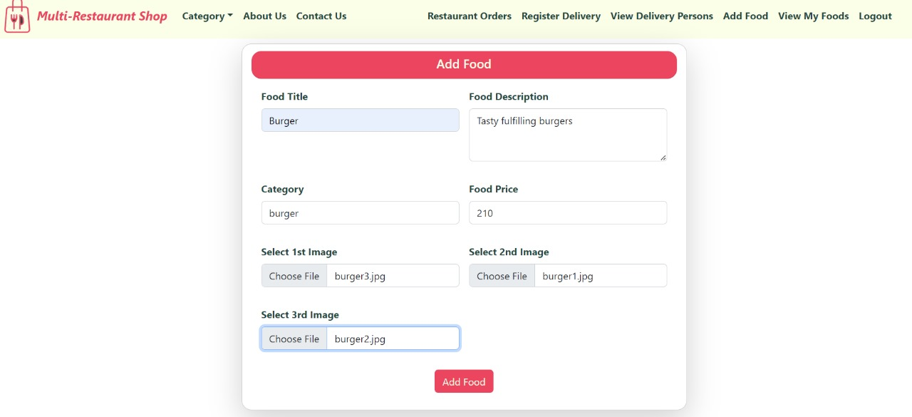
RESTAURANT OUTPUTS
My Foods
Add Food

Slide 17
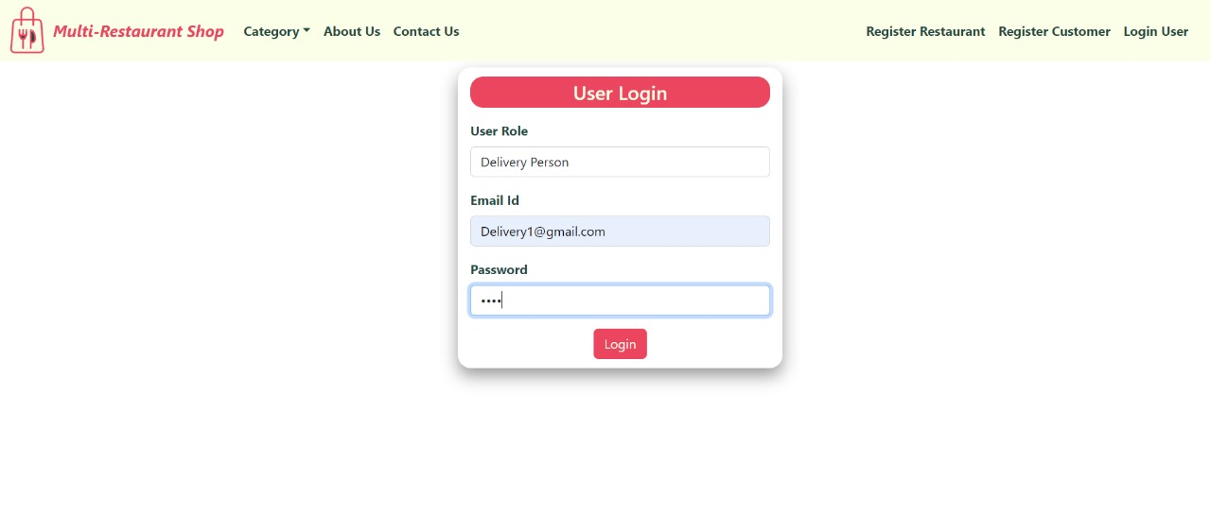
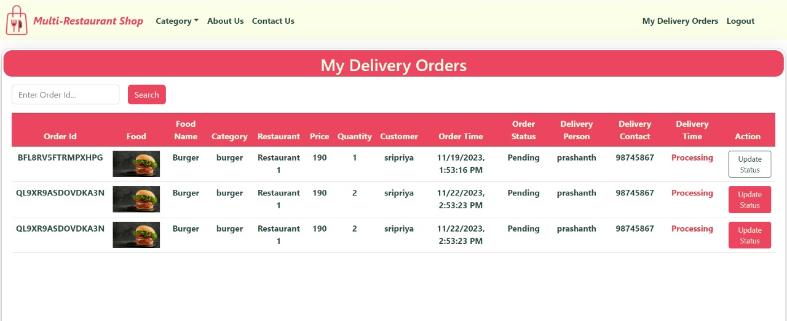
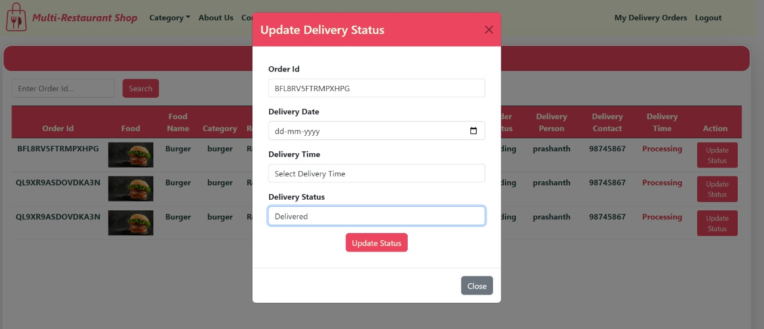
DELIVERY PERSON OUTPUTS
Delivery Login Page My Delivery Orders
Update Delivery Status

Slide 18
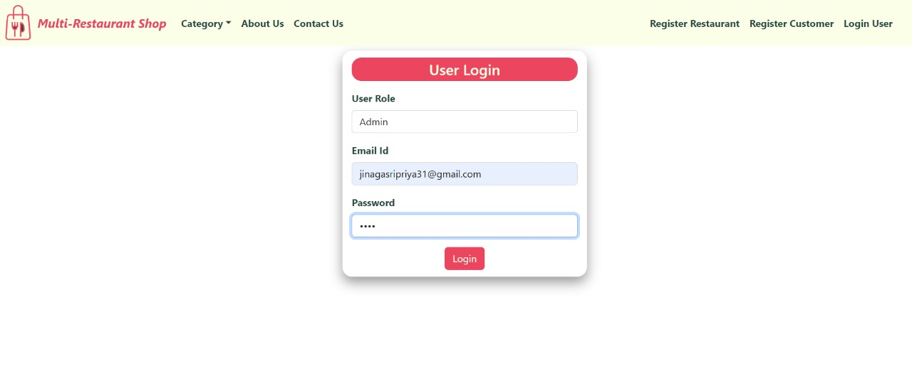
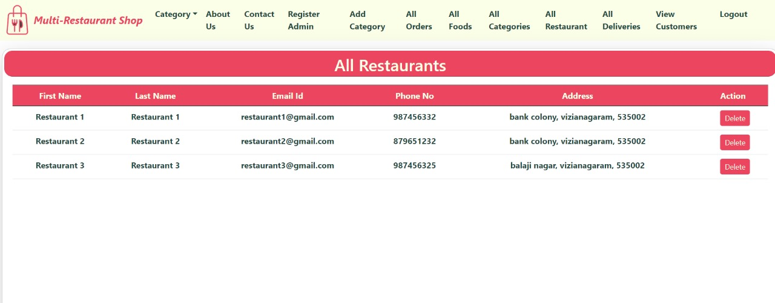
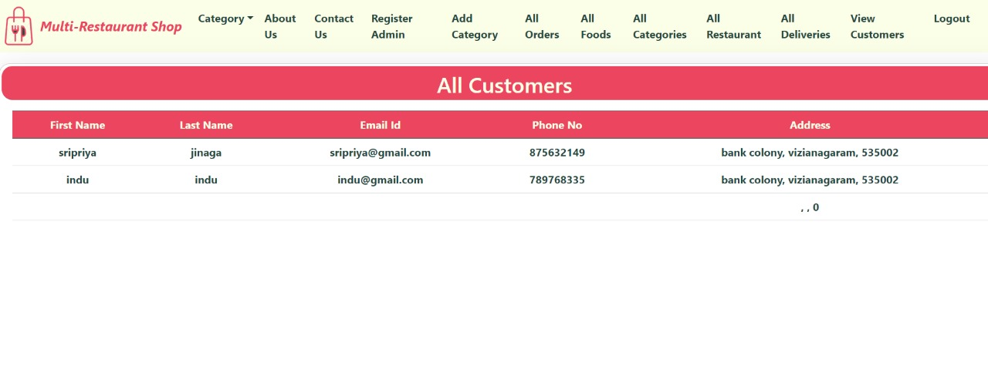
ADMIN OUTPUTS
Admin Login All restaurants
All customers

Slide 19
CONCLUSION
The development of an online restaurant management system using React.js for the frontend and Spring Boot for the backend represents a significant leap forward in streamlining restaurant operations, enhancing customer experiences, and improving overall efficiency. The integration of a modern and responsive user interface (UI) through React.js ensures a seamless and enjoyable experience for both customers and restaurant staff. Meanwhile, the robust backend powered by Spring Boot provides a scalable and secure foundation for managing orders, menus, and various other aspects of restaurant operations. The system facilitates real-time communication, enabling instantaneous updates on order statuses, menu changes, and customer interactions. Secure user authentication and authorization mechanisms enhance data security, ensuring that sensitive information is protected throughout the system. The utilization of RESTful APIs and a well-designed database schema ensures smooth communication between the frontend and backend components.The online restaurant management system offers features such as dynamic menu customization, efficient order processing, inventory management, and secure payment handling. These functionalities collectively contribute to operational efficiency, reduced costs, and an improved customer experience.

Slide 20


